Slide 1



Online Movie booking
Java SpringBoot Project

Slide 2


Table of
content
01.
Introduction
02.
Purpose
03.
Technologies Used
04.
User Interface

Slide 3


Introduction
Web Application: Manages movie ticket booking process.
User Interface: Built to be attractive and user-friendly.
Backend Technology: Utilizes Spring Boot and MySQL Database.
User Roles:
User: Can book movie tickets easily.
Admin: Has special rights and permissions within the application.
Process:
Sequence of forms provided with validations.
Ensures consistency, reliability, and correctness of information.
Admin Rights:
Reserved rights with respect to application management and data access.

Slide 4

PURPOSE
Enable seamless ticket booking for movies.
Offer real-time seat availability updates.
Allow selection of showtimes and seat types (Royal or Premier).
Simplify the booking process for a hassle-free experience.
Enhance user convenience for enjoying favorite blockbusters.

Slide 5
TECHNOLOGIES USED
Frontend: CSS, JavaScript, JSP
Backend: Java Spring Boot 3, Spring Data JPA, Spring Security
Database: MySQL 8.0
Build Tool: Maven
Code Editor and tools: Eclipse IDE
Server: Apache Tomcat 9

Slide 6

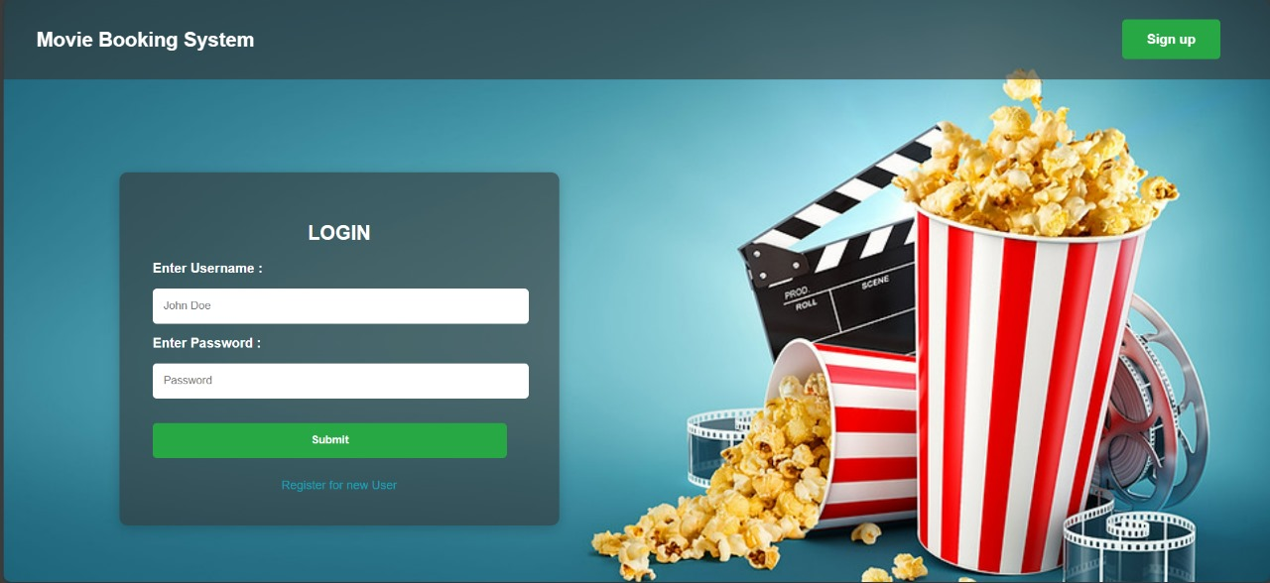
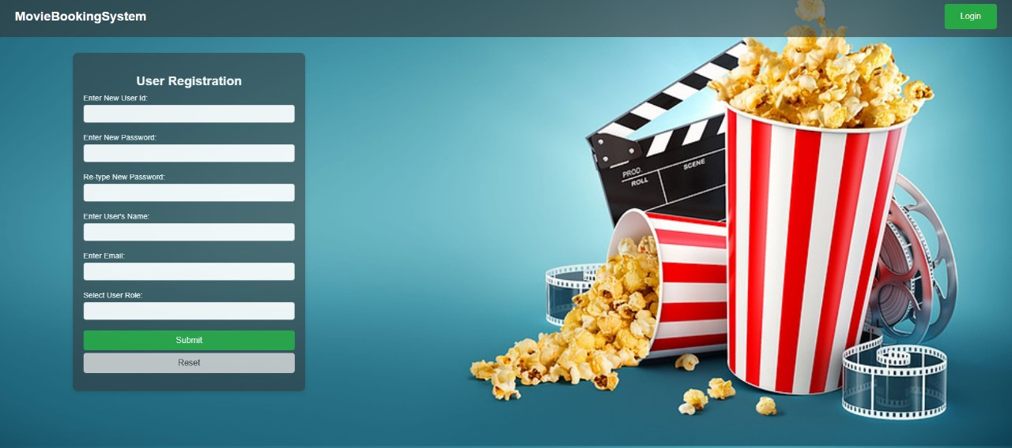
LOGIN /SIGN UP PAGE
LOG IN PAGE
REGISTRATION PAGE
This picture shows the login page of our application which helps the users and the admins to log-in into the application.
This picture shows the registration page for all the users including the admin and the customers to enter their information and what they want to log in as.

Slide 7
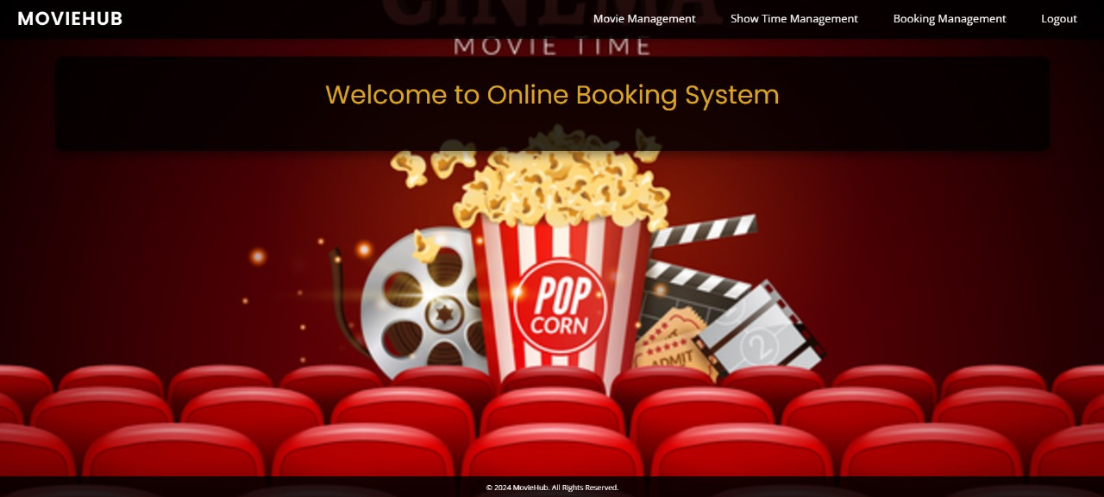
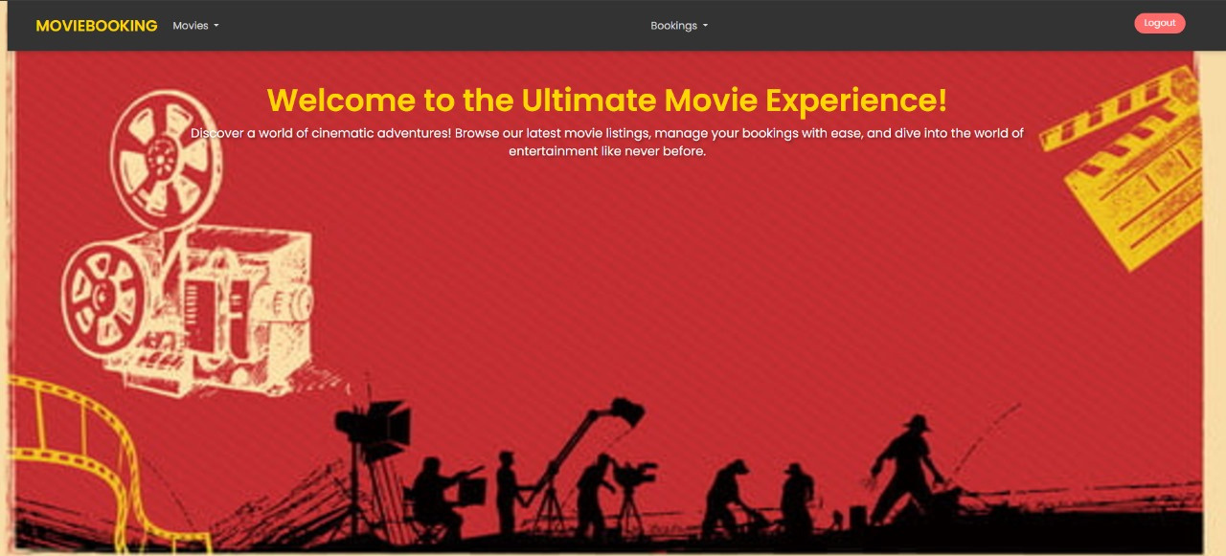
HOME PAGE OF APPLICATION
ADMIN INTERFACE
CUSTOMER INTERFACE
This picture demonstrates the login page of our application for user log in and admin login.
This picture demonstrates the login page of our application for user log in and admin login.

Slide 8
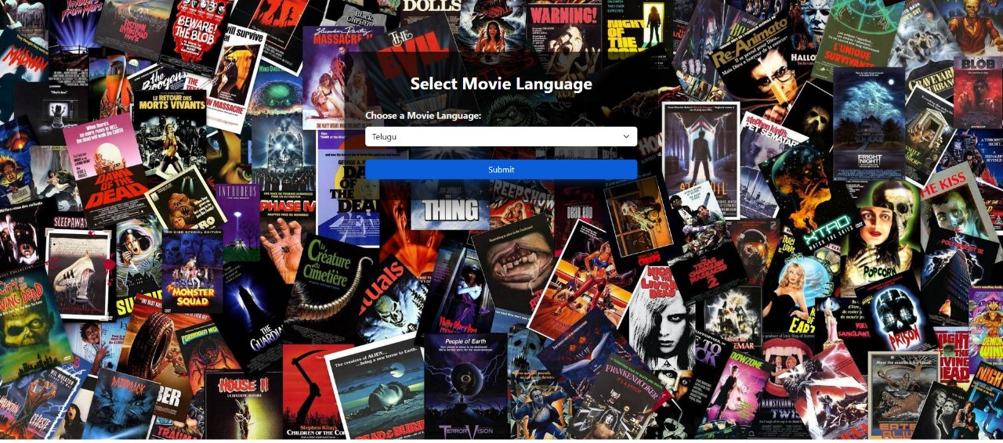
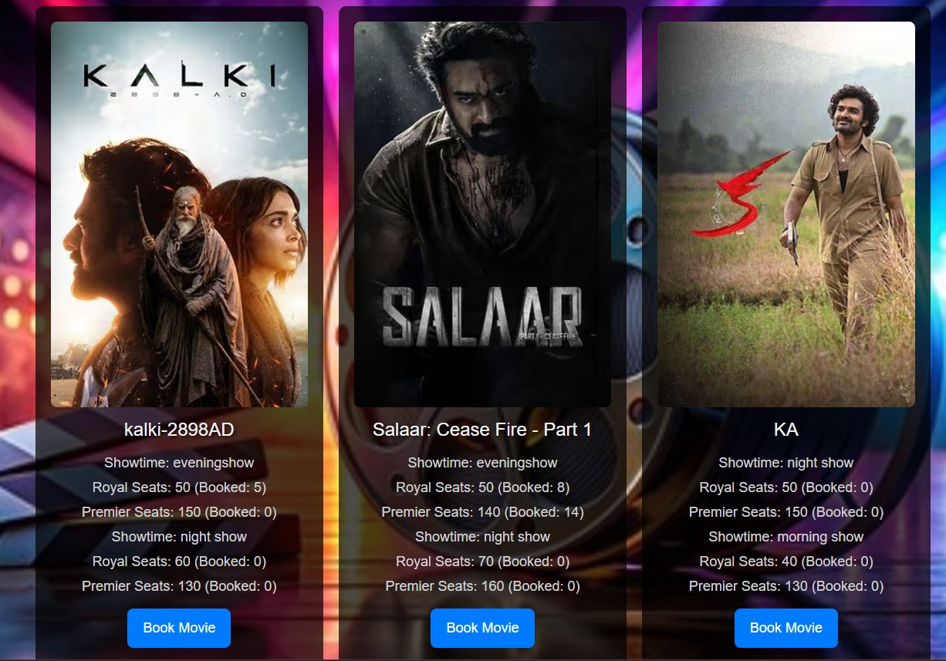
CUSTOMER MOVIE SELECTION
TICKET BOOKING SECTION
TICKET BOOKING CONFIRMATION
This features allows the customers to select their preferred Language of the movie the customer wants to watch and it filters out the movie of the same language accordingly.
This picture shows the names of the movie which are available in Telugu language according with the following details mentioned in the snapshot.

Slide 9
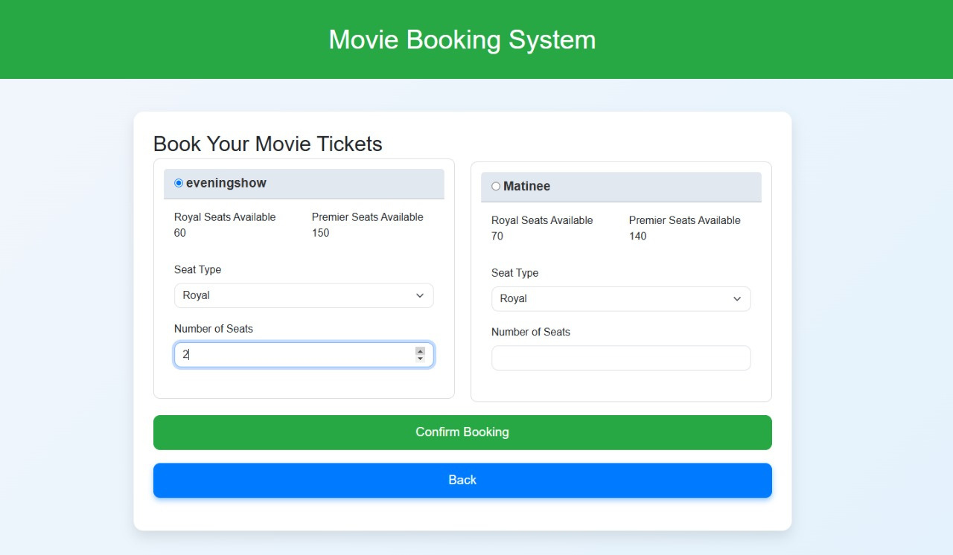
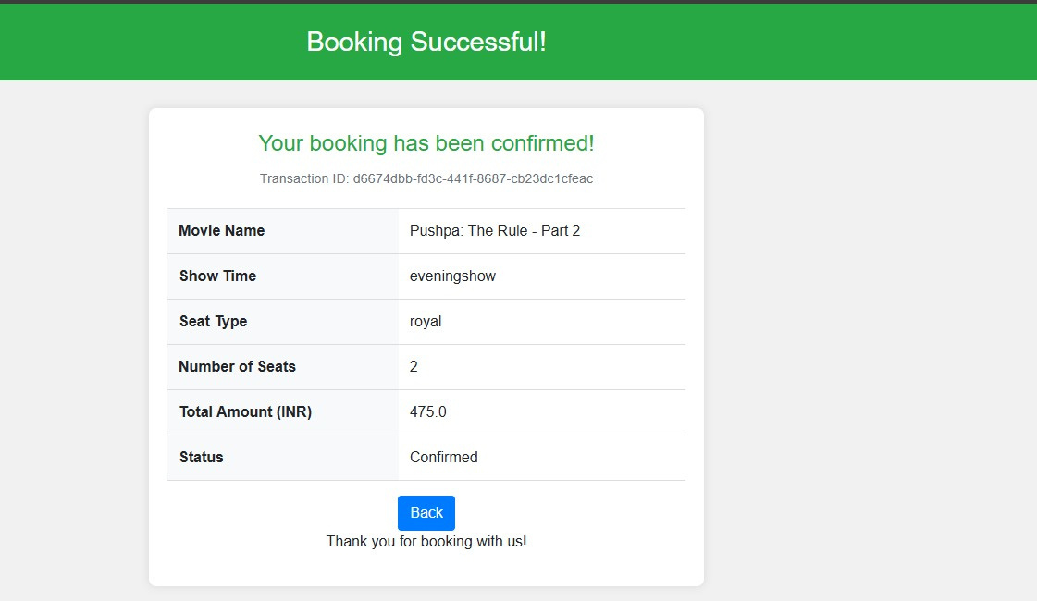
BOOKING PROCEDURE FOR CUSTOMER
TICKET BOOKING SECTION
TICKET BOOKING CONFIRMATION
The ticket booking section shows the price of the ticket and gives the features to customers to add the number of seats and the type of seats according to the customers choice.
The result shows the final booking of the movie and the desired seat for threater.

Slide 10
Future Implementation
Online Payment
Recommendations
Mobile Application
Online Payment Gateway can be one of the key features add to this application so that without standing in the queue customers can easily book tickets online.
AI based recommendations can be a mandatory features so that customers can get recommendations according to their choice and based on their previous bookings.
A mobile based application allows the customer to book tickets for movie shows on their mobile phones which allows them to make their bookings any time and any place.

Slide 11
Thank you
Under the guidance of
Suramya Biswas
TEAM MEMBERS
Sampath Banisetti
Anaya Kognole
Aditya Chopra
Janardhan Reddy
Chavva Sahithya

